Slide 1
Superstore Sales Performance

Slide 2
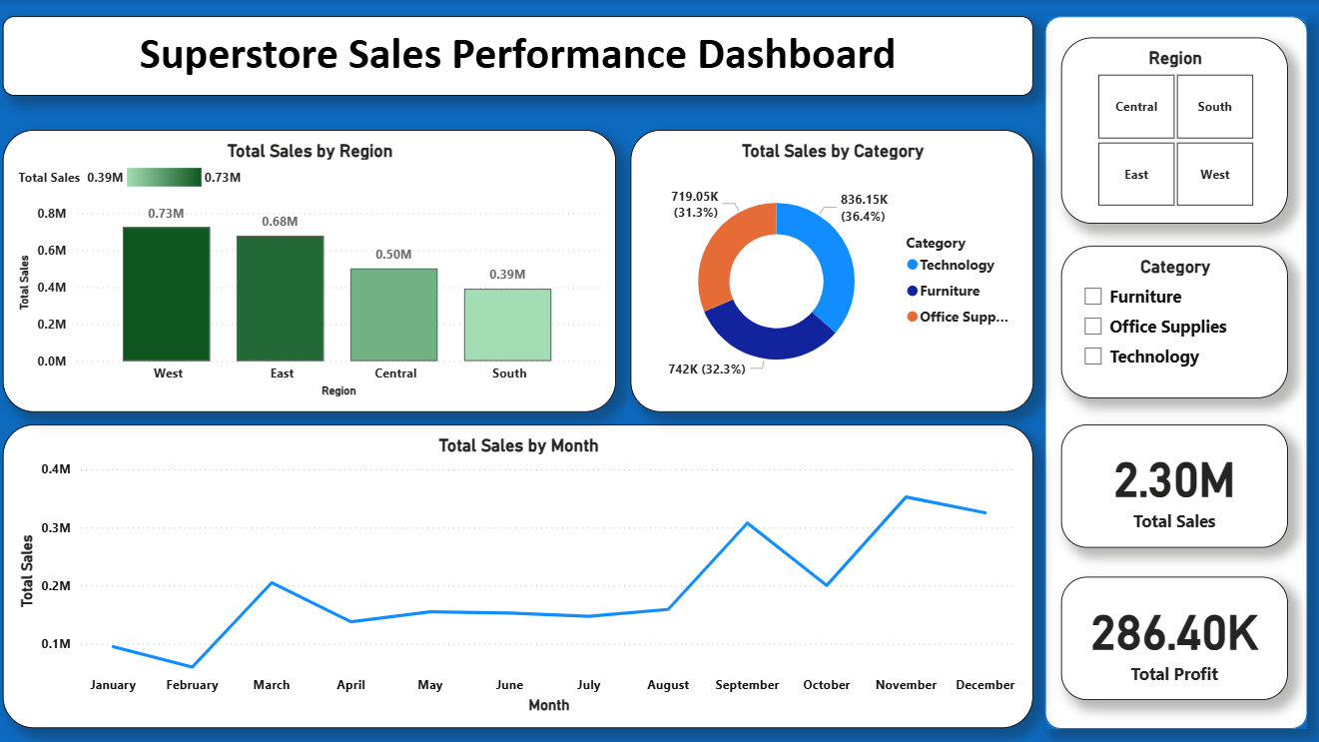

Slide 3

Sales Performance Insights
Strong Regional Performance
The West region delivered the highest sales, while the South lagged, highlighting significant regional differences in performance.
Technology Leads Sales Categories
Technology was the top-selling category, making the biggest contribution to total sales results.
Seasonal Sales Peaks
Sales reached their highest point in November, emphasizing the importance of fourth-quarter performance and seasonality.
Notes:
Image source: Microsoft 365 content library The West region achieved the highest sales, while the South recorded the lowest. Technology emerged as the leading category, contributing the most to total sales. Notably, sales peaked in November, illustrating strong seasonality in the fourth quarter and emphasizing the importance of year-end performance.

